Slide 2
What is Compass East?
Our Story
Dan McCarthy
Co-founder/President at Compass EAST
Notes:
Nashville just hosted the nfl draft. How many people watched or went downtown? And how many hid inside and waited for it all to be over?
I tried my best to avoid it this year, but in 2011 we were glued to the TV.
My business partner, John and I had been trying to narrow down our search for Where to start our business. We had grown up in a small town in PA with 5,000 people. But Now we were living in 2 different states.
“Maybe we should check out wherever Colin ends up”
so there We were family and friends all gathered around the TV when the announcement came: “With the 109th pick of the 2011 NFL draft, the Tennessee Titans select Linebacker Colin McCarthy.” And with that, the three of us were on our way to Nashville. One to work a job and the other 2 to start a company. So that’s HOW we got to Nashville, but the WHY we started compass east came a few years earlier.
Auditors. Wanted to solve problems and be part of the solution.
Compass East was Born.
Compass East is a tech-enabled, outsourced finance and accounting firm for growing companies. Rather than hiring a department full of F&A people, we become that department for our clients.

Slide 3
Compass EAST by the numbers
2011
Founded
$97MM
Assets Managed
17
Team
$75MM
Revenue Managed
Notes:
A lot has changed since our start in 2011.
We’ve grown from a team of 2 to a team of 17 people. We managed just shy of $100MM in assets and $75MM in revenue for our clients.
We’ve learned a lot along the way and I’d like to share some of those shortcuts with you today.

Slide 4
Today’s Goal
Identify proper F&A foundation for early stage companies
Recommended F&A Software
Understanding the impact of systems on the financial statements

Slide 5
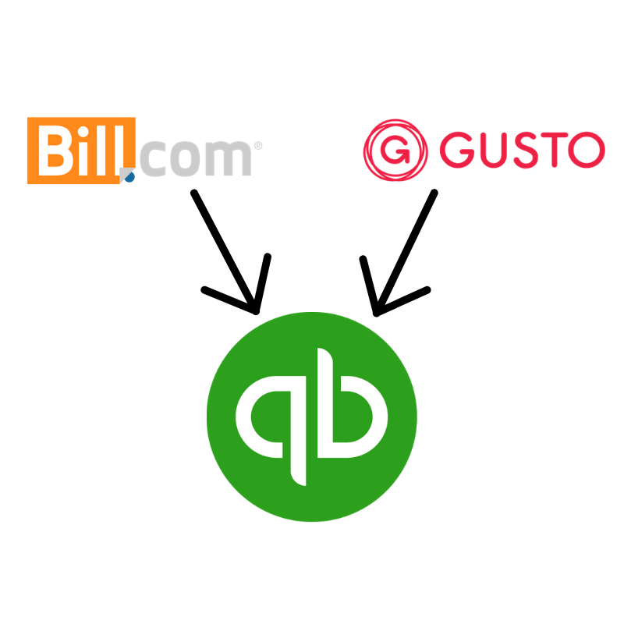
Core F&A Tech Stack
Accounting System - Quickbooks Online
Money in / Money Out (AR/AP) - Bill.com
Payroll - Gusto
Notes:
QBO - this is your accounting system, it holds the general ledger which is the record of all of your business transactions.
Bill.com - an Accounts Receivable and Accounts Payable system. Collecting on invoices and paying your bills. this extends the functionality of QBO.
Gusto - this is the most straightforward and user-friendly payroll system we have found.
Questions - We are going to cover a high-level overview of these 3 systems. Then I’d like to spend the majority of our time diving into the financial statements and how these systems interact with your financials.
If you can jot down any questions, I’ll take a few at the end of the systems review and then we will have time at the end for any questions.

Slide 6
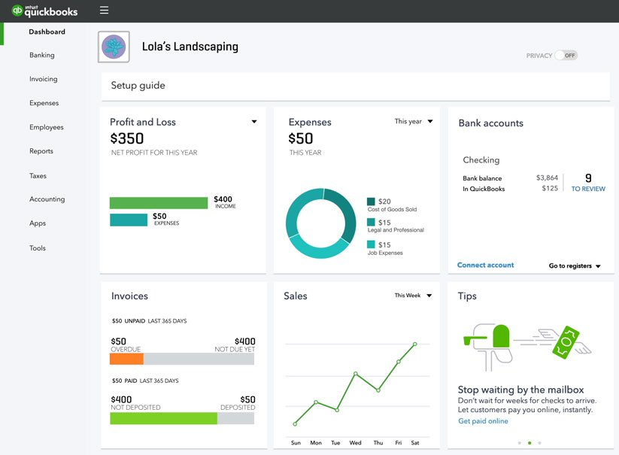
QBO
What does it do?
Cloud vs. Desktop
Chart of accounts
Common mistakes
Notes:
Why QBO
I go to both intuit QB connect and Xerocon (Xero is a competing cloud-based accounting software).
Intuit is a $6B annual revenue company. In 2018, $1.2B came from QBO and their online ecosystem, 40% growth YoY. $1.8B came from their desktop ecosystem, 8% YoY growth.
QBO - 3.4MM subscribers
Xero is a $400MM annual revenue company. 1.3 MM subscribers. Only 10% of those subscribers are in North America, they are primarily an Australia/New Zealand company. Xero grew operating revenue by 38%. YoY.
The move to the cloud - why not to use desktop accounting software:
At QBO Connect, there is a small section of the convention center dedicated to the Desktop QB - maybe 5% of the whole space. The rest is dedicated to QBO and all of the apps that connect to or extend QBO. Intuit steals the best features from not only competitors like Xero, but also it’s APP partners.
We research and use the best tech at the time. When Xero was better than QBO we had about 50/50. As QBO started taking their features, we are closer to 90/10 (QBO/Xero)
Top 3 QB Mistakes
setup incorrectly from the start - Chart of Accounts or Settings
Month end close - Not reconciling all accounts - if all accounts (bank, credit card, loan, etc) are not reconciled, you cannot be sure that all information is captured
Owners or Management ignoring their instincts - if it looks or feels wrong, or your accounting person can't explain it, it probably is wrong and worse than you think

Slide 7
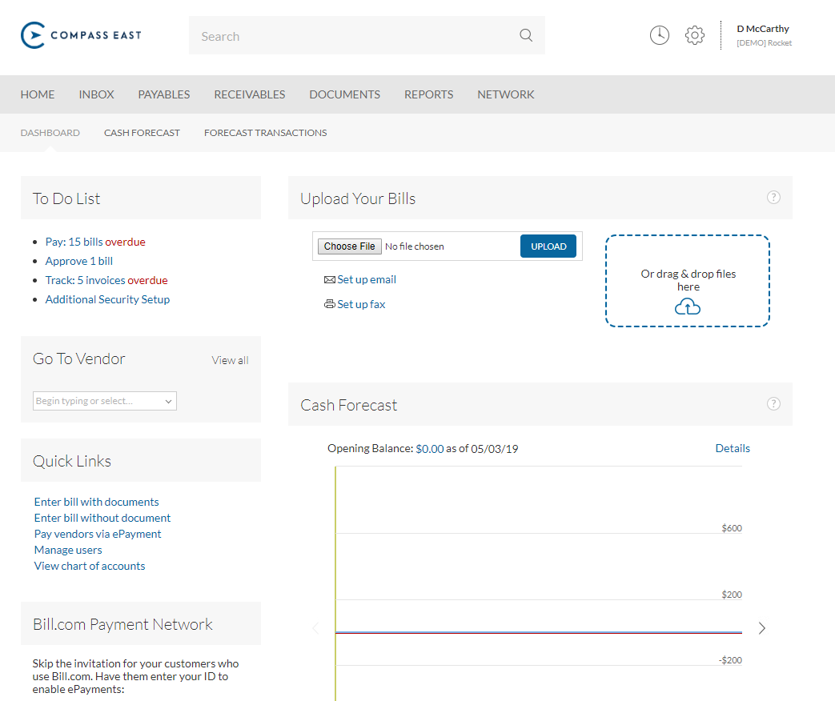
Bill.com
What does it do?
Manual -> Bank Bill Pay -> Bill.com
Save 50% of time on AP
Get paid 2-3x faster
Notes:
We use the AP feature for 100% of our clients where we manage AP. This is easily the software that wows our clients the most from the start. Approvals. ACH collections.

Slide 8
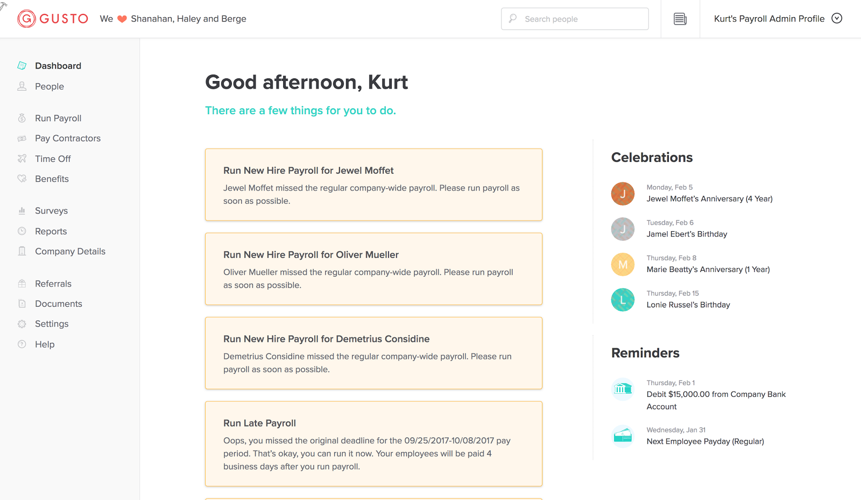
Gusto
Electronic onboarding
Compliance
Caging of taxes
Notes:
Service-based payroll co vs. tech-forward payroll company.

Slide 9
Financial Statements
Profit & Loss Statement
Balance Sheet
Cashflow
Statement
Notes:
P&L - Period of time. Date range. Chart of accounts
Balance Sheet - point in time. A date. Less comfortable
Cashflow = period of time. Go here first to see if things make sense

Slide 10
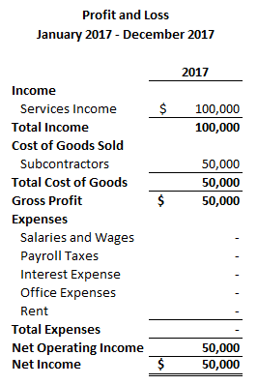
Notes:
We are going to assume a single member LLC. taxed as a disregarded entity. Sole Proprietorship. Schedule C on your personal 1040. Cash & Accrual were same for 2017.

Slide 11
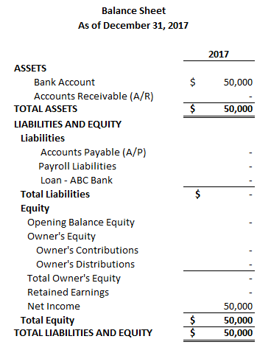
Notes:
Accounting Equation Assets = Liabilities + SE
Assets - What we Own or are Owed
Liabiltiies - What we Owe

Slide 12
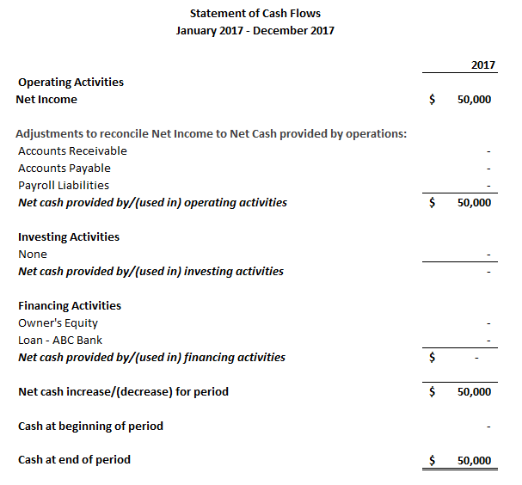

Slide 13
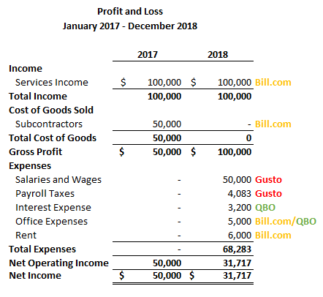

Slide 14
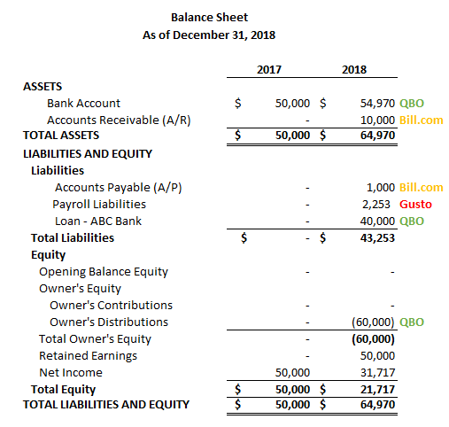

Slide 15
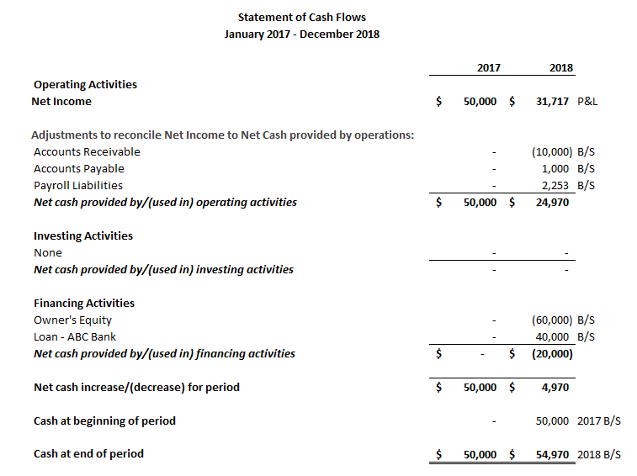

Slide 16
Q&A

Slide 17
Recap
Recommend QuickBooks Online, Bill.com, and Gusto
Your Financial Statements are your responsibility. Be comfortable with them from the beginning.

Slide 18
Contact Information
Finance and Accounting Department Assessment Checklist
Dan McCarthy
dan.mccarthy@compasseast.com

